Slide 1
Neural Network Architecture for Time Series
CYPHER 2019
Ankur Verma

Slide 2
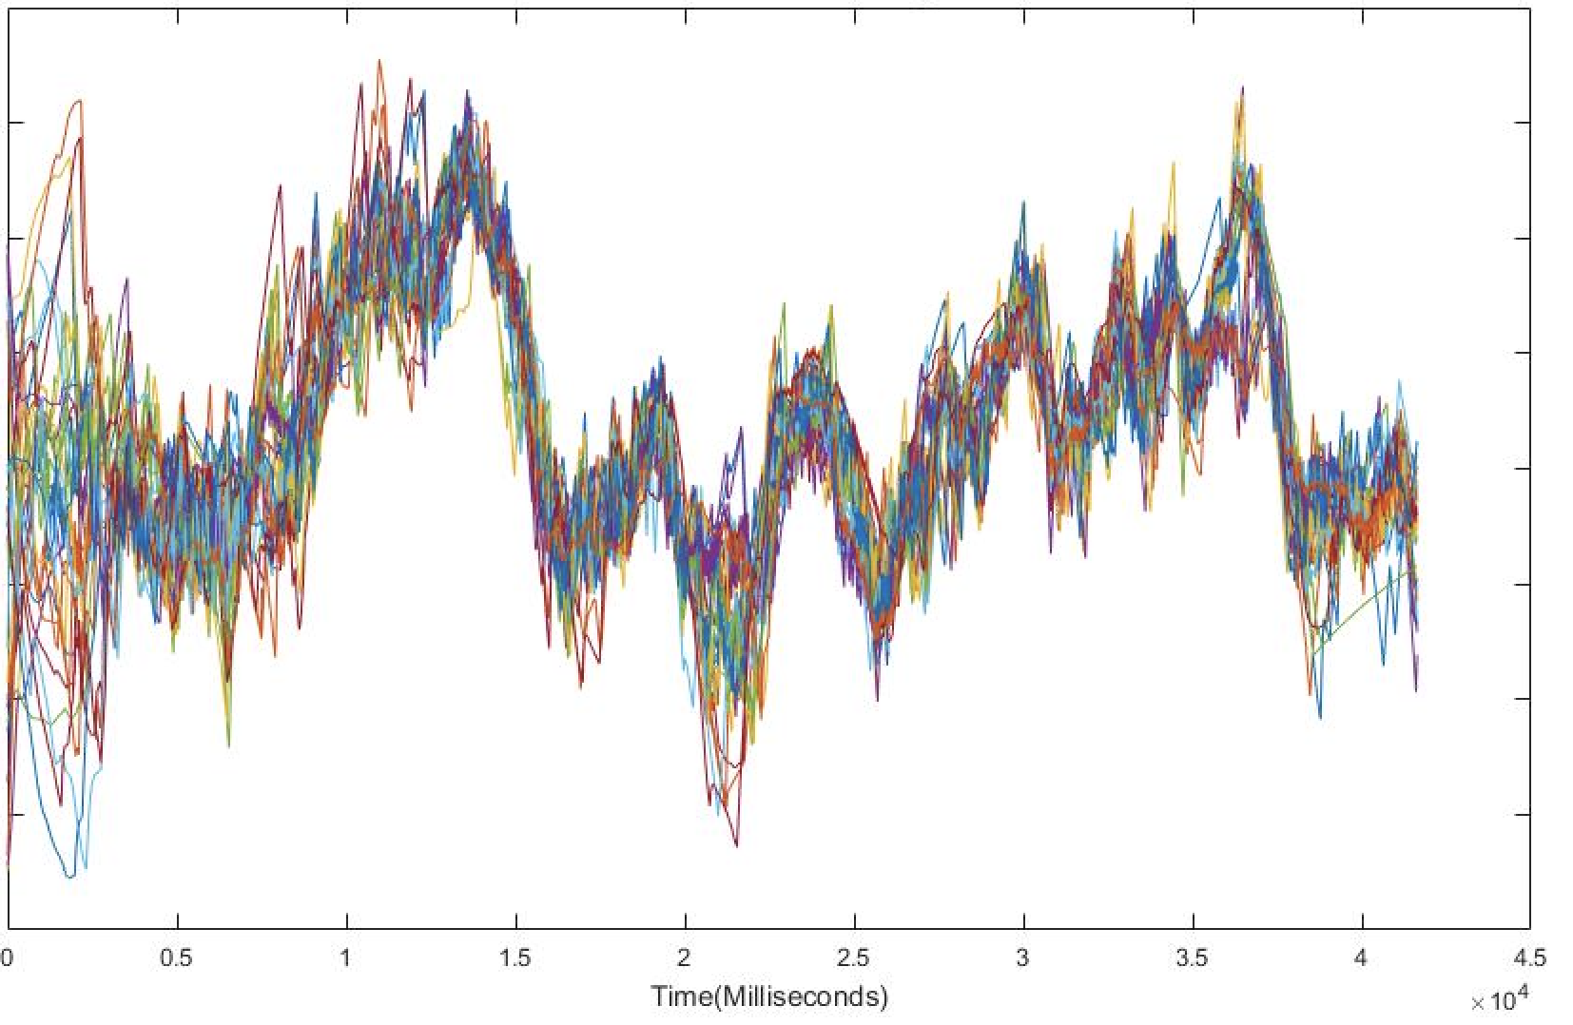
Business Problem
Multiple time series sales prediction using neural network architecture

Slide 3
Business use case
Demand - supply prediction for inventory planning so as to avoid
Out of stock
Excess inventory

Slide 4
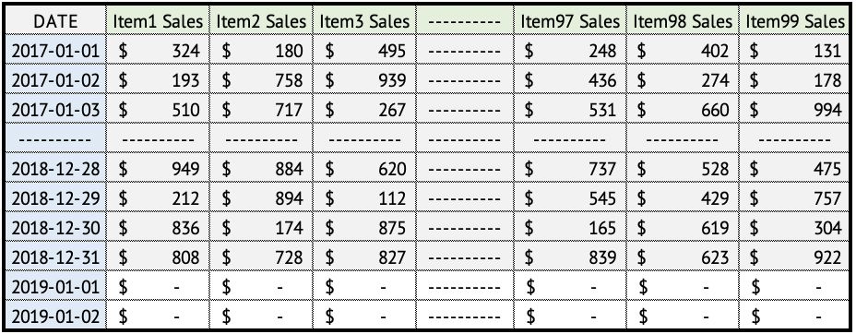
Time series data
Let’s have a look at the data

Slide 5
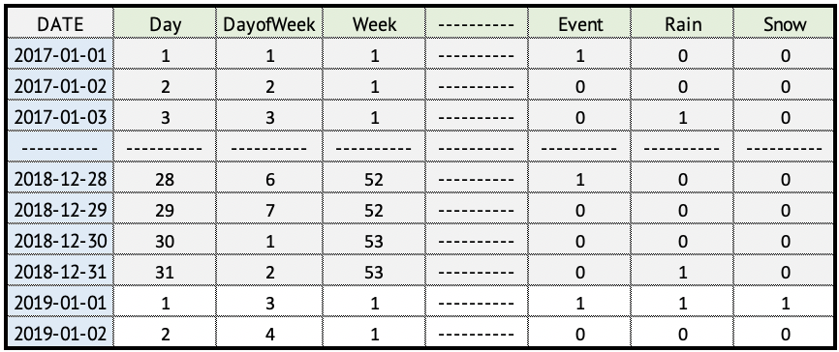
Feature Extraction - Temporal
Features having temporal component

Slide 6
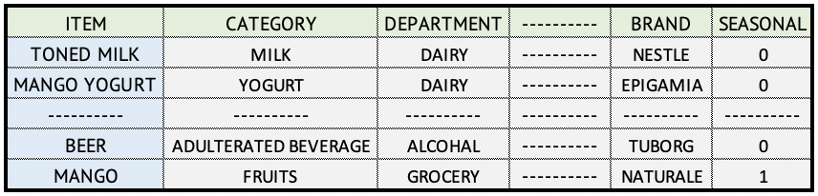
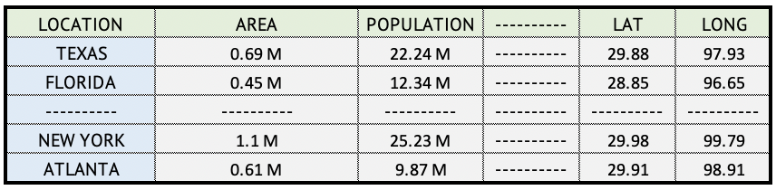
Feature Extraction - Static
Static features with no time dependency

Slide 7
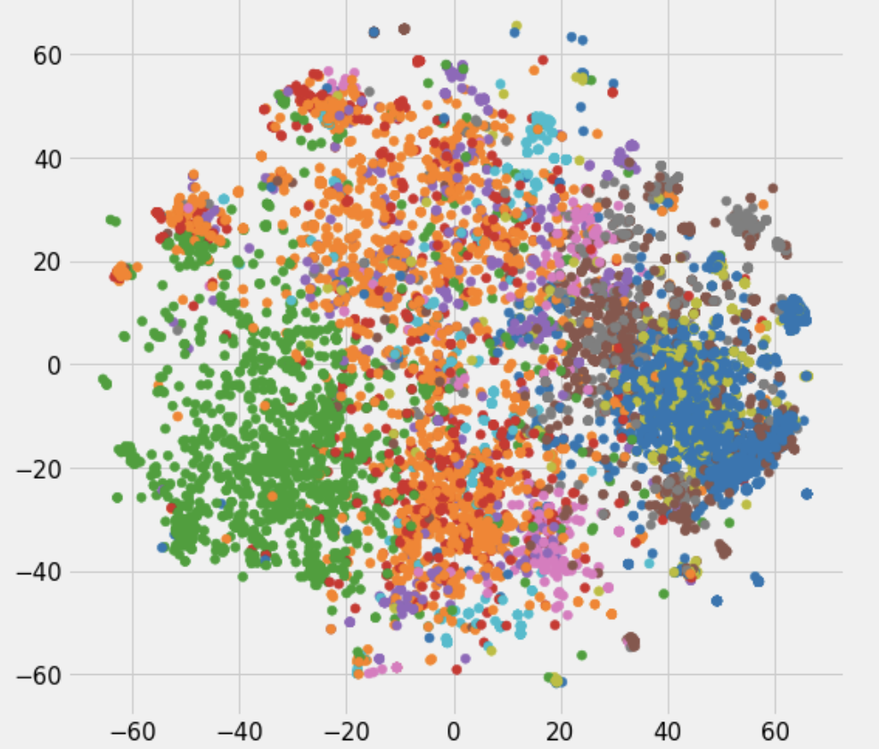
Embeddings
Spatial dimensionality reduction of categorical features

Slide 8
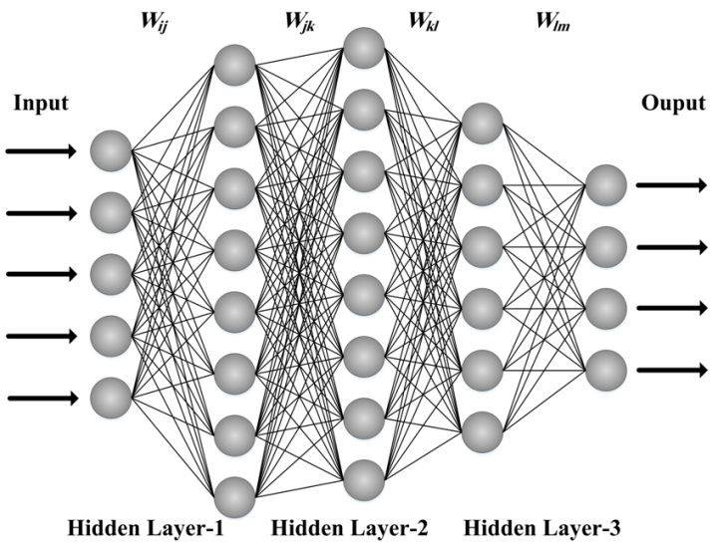
Multilayer Perceptron
Neural network with multiple layers

Slide 9
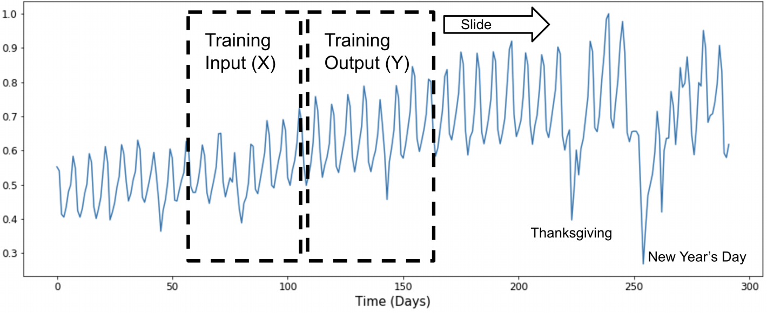
LSTM Model Training
Input output slider based on number of time steps

Slide 10
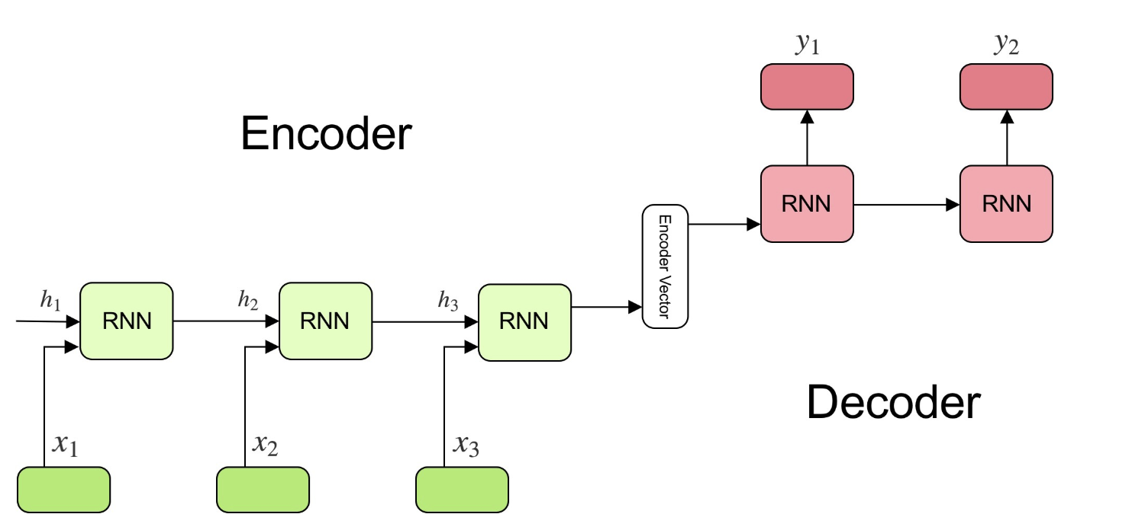
Sequence to Sequence Models
Encoder decoder sequence to sequence model

Slide 11
Architecture
INPUT DATA
MINI BATCHES
INPUT TENSORS
TIME SERIES
TEMPORAL EMBEDDING
DAY, DAYOFWEEK, WEEK, EVENTS, RAIN, SNOW
TEMPORAL CONTINUOUS
AVG PRICE, AVG COST, TEMPORAL ENCODINGS
ITEM
STATIC
EMBEDDING
ITEM, CATEGORY, DEPARTMENT, BRAND, LOCATION
LOCATION
STATIC
CONTINUOUS
AREA, POPULATION, LATITUDE, LONGITUDE
TARGET
VARIABLE
SALES

Slide 12
Architecture continued
INPUT TENSORS
INPUT LAYER
HIDDEN LAYER
LSTM LAYER
OUTPUT LAYER
TEMPORAL EMBEDDING
3D MULTI EMBEDDING LAYER
MULTILAYER PERCEPTRON
LINEAR
LAYERED
LSTM
ENCODER - DECODER
SALES
PREDICTION
TEMPORAL CONTINUOUS
3D INPUT LAYER
STATIC
EMBEDDING
2D MULTI EMBEDDING LAYER
MULTILAYER PERCEPTRON
MULTIPLE
LAYERED
STATIC
CONTINUOUS
2D INPUT LAYER

Slide 13
Q & A

